Slide 1

Final projet TCI
Designer : Chebchoub Mohamed
Prof : Dr Bouchekir Redouane
Group ID : 8
University : USTHB
Groupe Members :
Chebchoub Mohamed
Amara Taki Eddine
Arabi yasser
Boutarbiat Yassine
Souiher Akram Eddine

Slide 2
Defining Information and Communication Technology :
Information and Communication Technology (ICT) refers to the use of technology to manage and communicate information. It is a key foundation of the modern economy through digital products, software, networks, and services. ICT helps organizations improve business processes, expand global trade, and strengthen relationships. Today, effective strategic use of ICT greatly influences an organization’s productivity and innovation in the 21st century
Introduction To TCI
Definition
Report Objectives and Structure
Report objectives and Structuret :
This document aims to evaluate four key ICT tools: Google Services, Microsoft Office Suite, Git, and GitHub. It highlights their strengths and explains how they work together to form an effective digital ecosystem. The report reviews the productivity suites first, then the development tools, and concludes with their combined use in enterprise ICT systems, forming the foundation for future assignments.

Slide 3
What we study in TIC :
TIC
MICROSOFT OFFICE
LA TEX
HTML & CSS
GIT Hub & GIT

Slide 4
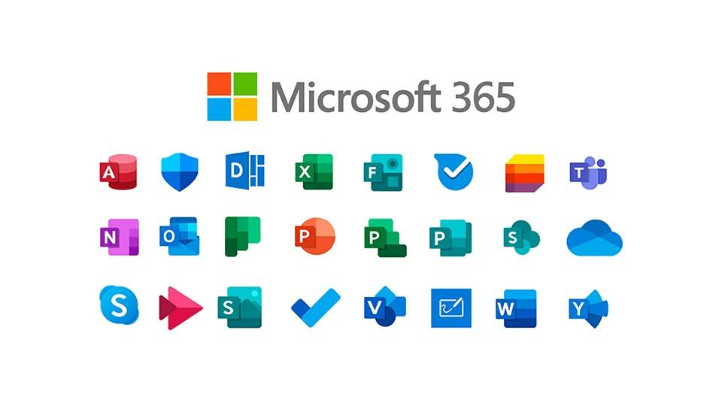
Microsoft APP:

Slide 5


LA TEX:
Definition:
A milky or colored juice in certain plants in cavities (called latex cells or latex tubes). It contains the peculiar principles of the plants, whether aromat-ic, bitter, or acid, and in many instances yields caoutchouc upon coagulation.

Slide 6
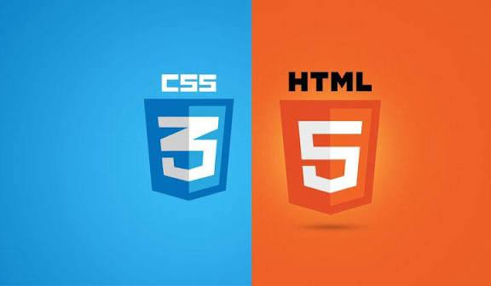
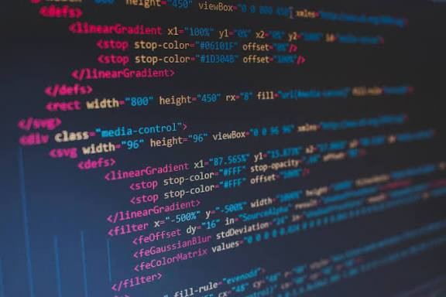
HTML & CSS:
DEFINITION :
HTML (HyperText Markup Language) and CSS(Cascading Style Sheets) are the two core technologies used to build and style web pages. HTML provides the structure and content, while CSS defines its visual presentation and layout.

Slide 7

GIT & GIT HUB :
GIT : | GIT HUB:
Tool (software) | Platform (website/service)
Works Locally | Works online
Version control system | Git repository hosting

Slide 8
Challenges and future:
Cybersecurity: Threats such as ransomware and phishing that endanger data integrity.
• Access Inequality: Bridging the digital divide between different regions.
• System Reliability: Reducing vulnerabilities in critical infrastructure.
• Ethical Issues: Ensuring data privacy and reducing AI bias through strong regulatory frameworks.
• Skills Development: Continuous workforce upskilling to keep pace with rapid innovation.
Future Horizons:
• 6G Networks: Enabling autonomous systems and ultra-low latency communication.
• Green Technology: Sustainable data centers and energy-efficient devices.
• Quantum Computing: Transforming problem-solving in medicine, logistics, and other fields.
Emerging Trends:
• Distributed technologies such as blockchain and brain–computer interfaces.
• Predictive analytics in healthcare, edge computing, and advances in natural language processing.
• Collaborative robots improving efficiency and safety in manufacturing.
• New fields like space ICT and underwater communication expanding connectivity to hard-to-reach environments.

